Slide 1
Econometric Analysis of Panel Data
Fixed Effects and Random Effects: Extensions
  Time-invariant Variables
  Two-way Effects
  Nested Random Effects

Slide 2
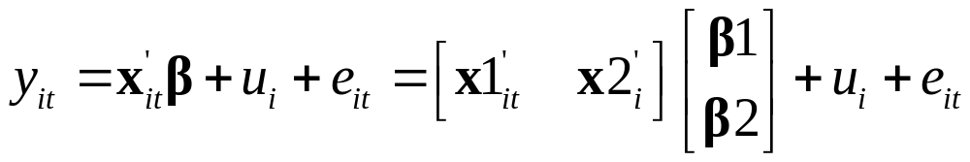
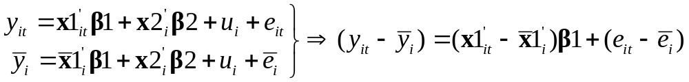
Time Invariant Variables
The Model
Fixed Effects
  β2 can not be identified, thus the individual effects u_{i} can not be estimated.

Slide 3
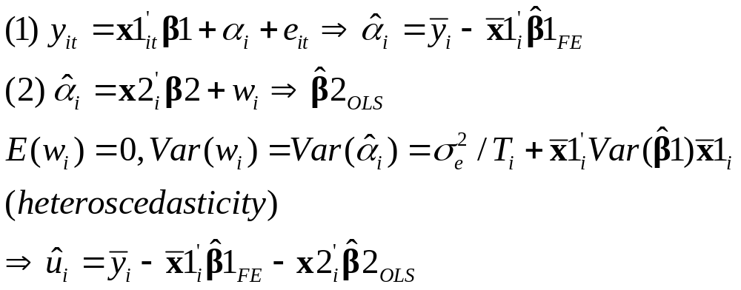
Time Invariant Variables
Fixed Effects: Two-Step Approach

Slide 4
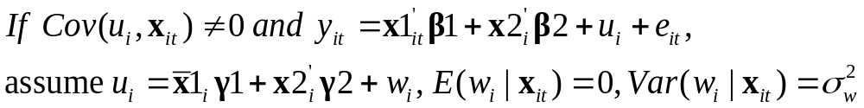
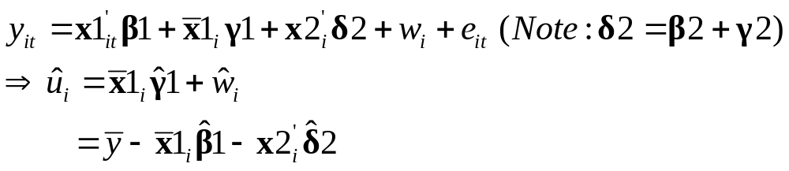
Time Invariant Variables
Random Effects
  Mundlak’s Approach
    Estimate random effects model including group means:

Slide 5

Example: Returns to Schooling
Cornwell and Rupert Model (1988)
Data (575 individuals over 7 ears)
  Dependent Variable y_{it}:
    LWAGE = log of wage
  Explanatory Variables x_{it}:
    Time-Variant Variables x1_{it}:
      EXP = work experience
      WKS = weeks worked
      OCC = occupation, 1 if blue collar,
      IND = 1 if manufacturing industry
      SOUTH = 1 if resides in south
      SMSA = 1 if resides in a city (SMSA)
      MS = 1 if married
      UNION = 1 if wage set by union contract
    Time-Invariant Variables x2_{i}:
      ED = years of education
      FEM = 1 if female
      BLK = 1 if individual is black

Slide 6
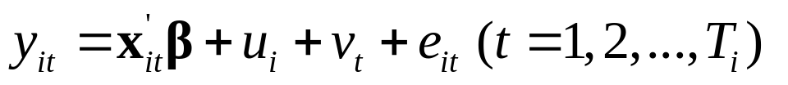
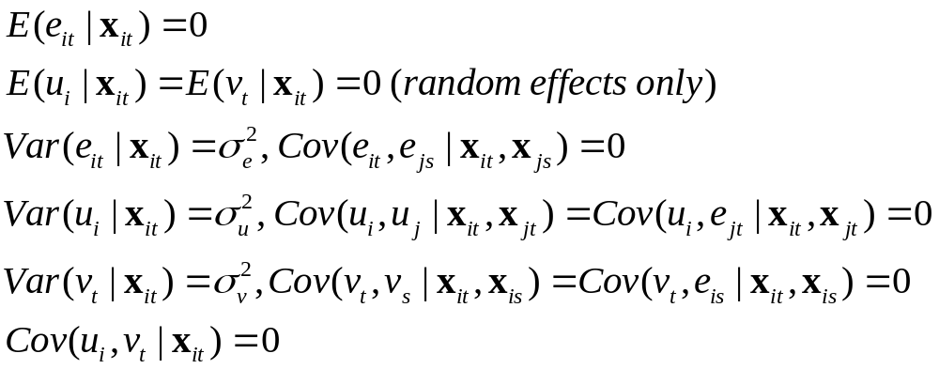
Two Way Effects
The Model
Assumptions

Slide 7
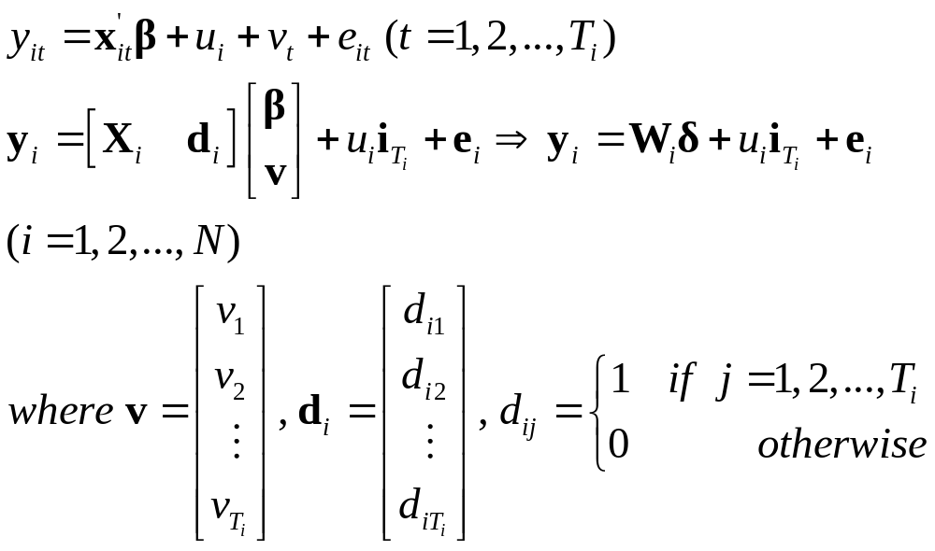
Two-Way Effects
Dummy Variable Representation

Slide 8
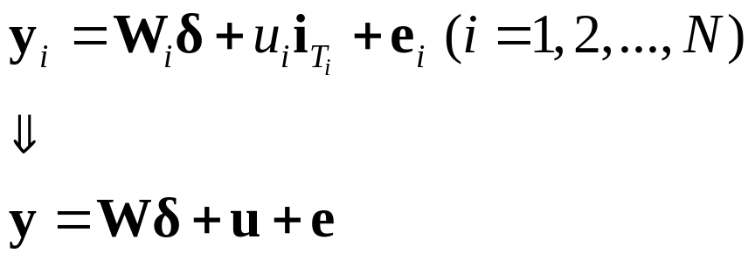
Two-Way Effects
Using one-way fixed effects or random effects model to estimate the dummy variable representation of two-way effects model.

Slide 9
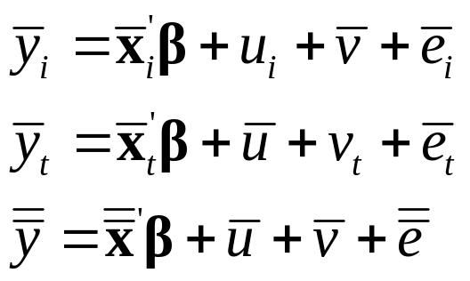
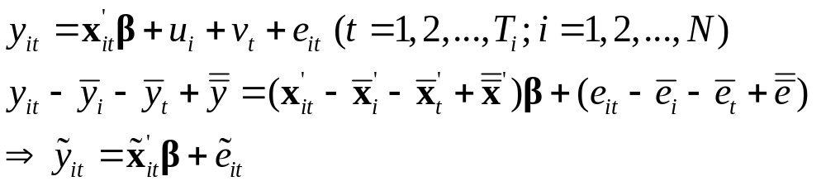
Two-Way Effects
Two-Way Fixed Effects Model
  Between Estimator
  Within Estimator (Group Means Deviations)

Slide 10
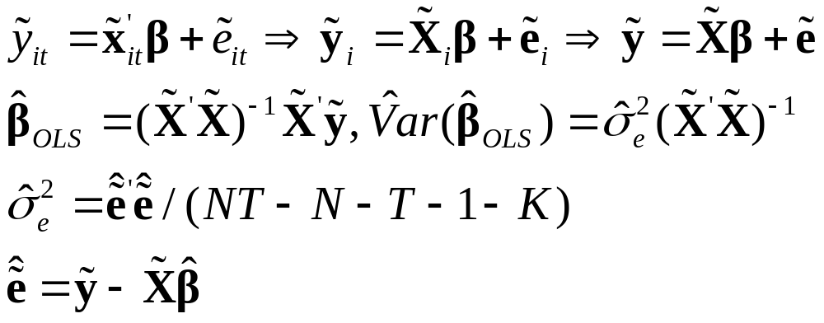
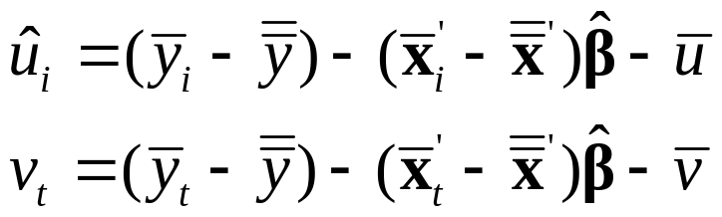
Two-Way Effects
Two-Way Fixed Effects Model
  OLS
  Estimated Individual and Time Effects

Slide 11
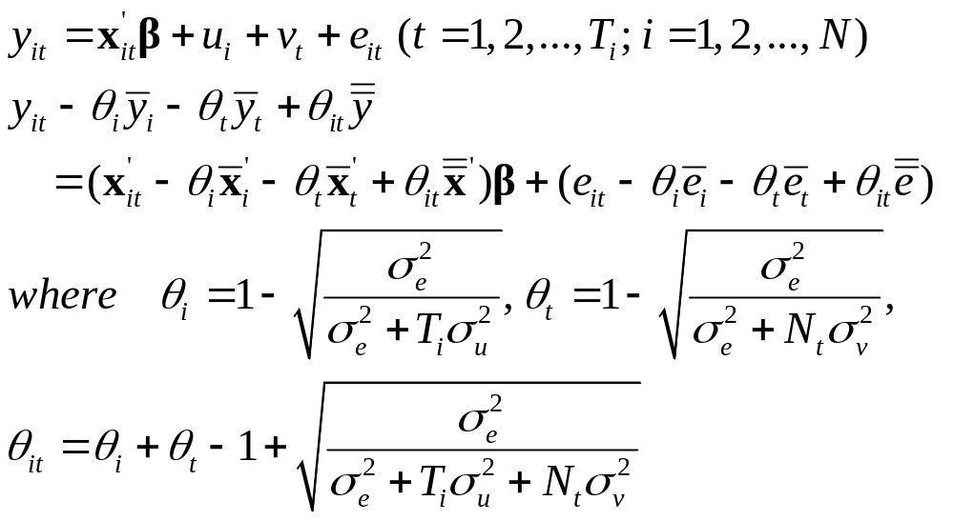
Two-Way Effects
Two-Way Random Effects Model
  Partial Group Means Deviations

Slide 12
Two-Way Effects
Two-Way Random Effects Model
  Consistent estimates of θs are derived from:
    σ_{e}² asym. var. of two-way fixed effects model
    σ_{u}² asym. var. of between (individual) effects model or one-way fixed (individual) effects model
    σ_{v}² asym. var. of between (time) effects model or one-way fixed (time) effects model
  For improved efficiency, iterate the consistent estimation until convergence.

Slide 13
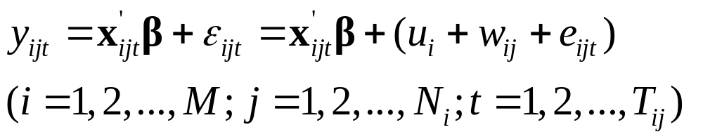
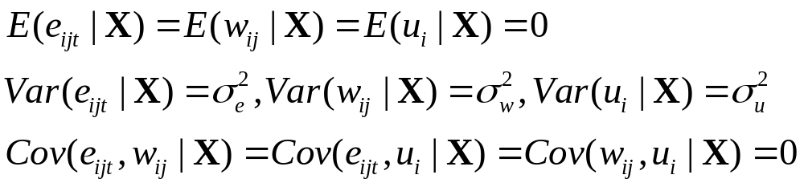
Nested Random Effects
Three-Level Model
Assumptions
  Each successive component of error term is imbedded or nested within the preceding component
Model Estimation
  GLS, ML, etc.

Slide 14
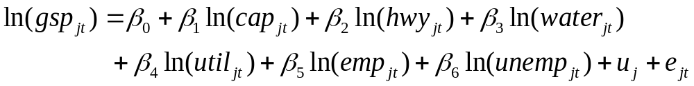
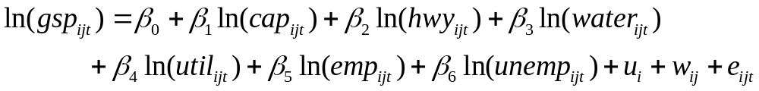
Example: U. S. Productivity
The Model (Munnell [1988])
  Two-level model
  Three-level model
  See, B.H. Baltagi, S.H. Song, and B.C. Jung, The Unbalanced Nested Error Component Regression Model, Journal of Econometrics, 101, 2001, 357-381.

Slide 15
Example: U. S. Productivity
Description
  i=1,…,9 regions; j=N_{i} states
    6. Gulf: AL, FL, LA, MO
    Mid West: IL, IN, KY, MI, MN, OH, WI
    Mid Atlantic: DE, MD, NJ, NY, PA, VA
    8. Mountain: CO, ID, MT, ND, SD, WY
    1. New England: CD, ME, MA, NH, RI, VT
    South: GA, NC, SC, TN, WV
    7. Southwest: AZ, NV, NM, TX, UT
    Tornado Alley: AK, IA, KS, MS, NE, OK
    9. West: CA, OR, WA
  t=1970-1986 (17 years)

Slide 16
Example: U. S. Productivity
Productivity Data
  48 Continental U.S. States, 17 Years:1970-1986
    STATE = State name,
    ST_ABB = State abbreviation (Region = 1, . . . , 9),
    YR = Year (1970, . . . ,1986),
    PCAP = Public capital,
    HWY = Highway capital,
    WATER = Water utility capital,
    UTIL = Utility capital,
    PC = Private capital,
    GSP = Gross state product,
    EMP = Employment,
    UNEMP = Unemployment

